Slide 1
DVCS && GIT
« I'm an egotistical ***, and I name all my projects after myself.» Linus Torvalds

Slide 2
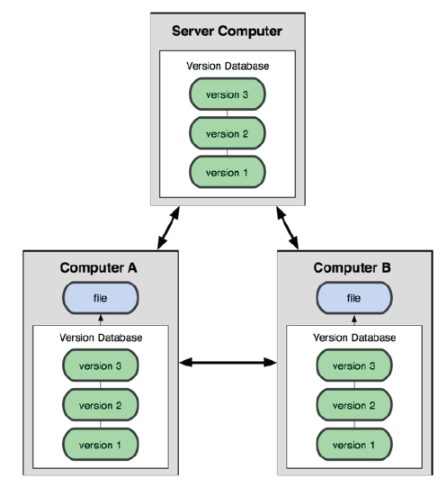
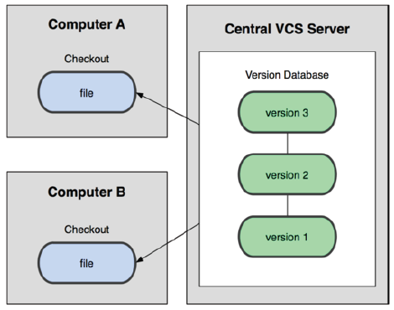
What is a DVCS ?
DVCS
Central VCS

Slide 3
 | GIT | Mercurial (Hg)
Which is the best ? | No real answer
OS | Mac, Windows, Unix-like
License | GPL
performance | Equivalent (Hg is faster with http)
Users | Linux, Microsoft, Google, LinkedIn, Facebook, Gnome, Eclipse KDE, Android, Debian, Ruby on Rails, Qt, Boost, Juce | Python, Go, Symbian, Netbeans
Repository size | 100% | 150%
features | Functions are almost the same (Git, do everything offline, git can fetch servers without modifying your repo, Hg can not)
scripting | Bash, and lots of frontend including Python | Easyer with Python
Versions id | Version Ids are SHA1 | Numbers & SHA
Clients | Both have great clients (some support Hg and Git)
Compatibility | Can both work from SVN ad there is a bridge between Hg and Git

Slide 4
Git VCS operations
repository
checkout
commit
add
untracked
unmodified
modified
remove
$ git status (to show the working tree status)
$ git diff (to compare commits, or commits and working tree…)

Slide 5
You sayed « D »vcs ?
Remote repository
pull
push
repository
checkout
commit
add
untracked
unmodified
modified
remove

Slide 6
Demo 1
Create a repository on the PC
What is in .git folder
Create a readme file, and add it to the index
Commit the file
Clone the repository on the MAC
Modify the readme file
Commit it
Check that nothing changed on the PC
Push from the MAC
Recheck on the PC
Modify the file again on the PC and commit
Pull from the MAC

Slide 7
With a server (remotes)
Adrien public
(bare)
John’s
repository
Adrien’s
repository

Slide 8
Demo 2
Create a barerepo on the PC (called .git)
Show the main folder
Create a clone on the PC
Add the readme file, and push it
Clone the repository on the MAC
Modify the readme file push the change
Pull from PC

Slide 9
You sayed « D »vcs ? (remotes)
development
Repository
(bare)
John’s
repository
Adrien’s
repository

Slide 10
You sayed « D »vcs ? (remotes)
Build repository
Philippe’s
repository
Kevin’s
repository
development
repository
Emily’s
repository
Adrien’s win repository
Adrien’s mac repo

Slide 11
Branching in Git (what is a branch)
A branch is a local concept
With SVN you checkout 1 branch from the server, it is a virtual folder
With Git you « really » branch a graph of snapshots

Slide 12
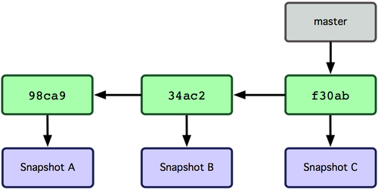
Branching in Git (the master branch)
The data is stored like a graph of commit objects,
which are pointing to snapshots
A branch is a simple object pointing to a commit

Slide 13
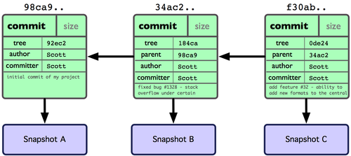
Branching in Git (what is a branch)

Slide 14
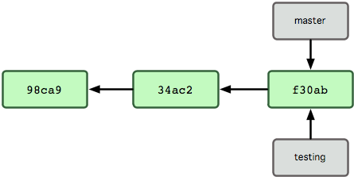
Branching in Git (what is a branch)
$ git branch <name_of_the_branch> ## create the branch
$ git checkout <name_of_the_branch> ## switch
$ git checkout –b <name_of_the_branch> ## create and switch
$ git branch ## list all branches and a star shows where you are

Slide 15
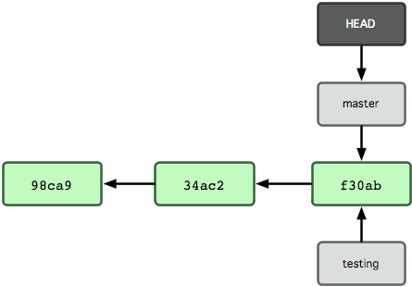
Branching in Git (what is a branch)
When you clone a repository your HEAD is on the master branch.

Slide 16
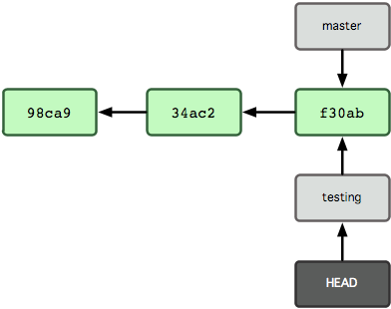
Branching in Git (what is a branch)
Do a « $ git checkout » is just moving the HEAD pointer
$ git checkout –b <branchname> ## will branch and switch

Slide 17
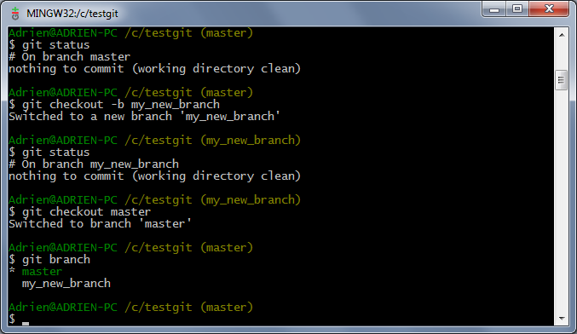
Branching in Git (Where are you ?)

Slide 18
Demo 3
Create a branch
Checkout
List branches
…

Slide 19
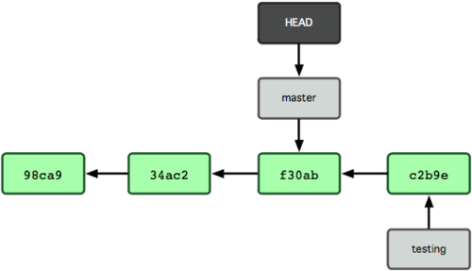
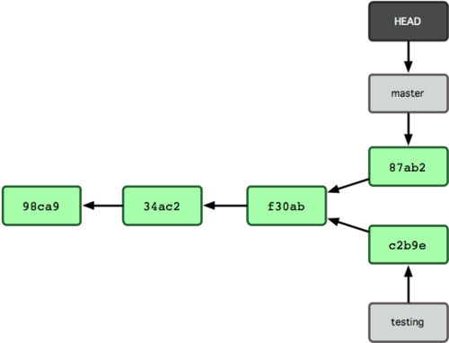
Branching in Git (A branch life)
$ touch test.cpp ## change something
$ git commit –a –m«a change» ## commit all changes
$ git checkout master
$ touch test.cpp ## change something
$ git commit –a –m«another change»

Slide 20
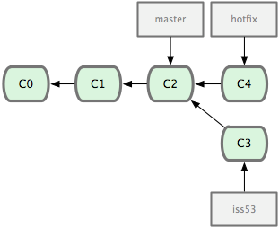
Branching and merging in Git (A branch life)
$ git checkout -b iss53
$ git commit –a « the C3 commit »
$ git checkout master
$ git checkout –b hotfix
$ git commit –a « the C4 commit »
We want to merge master and hotfix, this is a simple fast forward merge

Slide 21
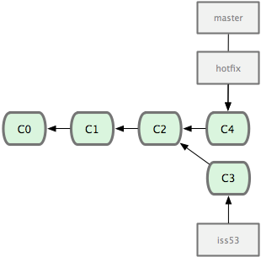
Branching and merging in Git (A branch life)
$ git checkout master
$ git merge hotfix ## merges hotfix into master
Updating f42c576..3a0874c
Fast forward
README| 1 –
1 files changed, 0 insertions(+), 1 deletions(-)
$ git branch –d hotfix
Deleted branch hotfix (3a0874c).

Slide 22
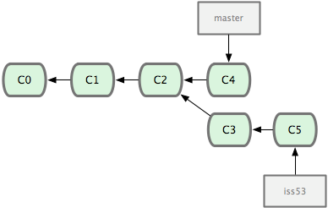
Branching and merging in Git (A branch life)
another commit into iss53

Slide 23
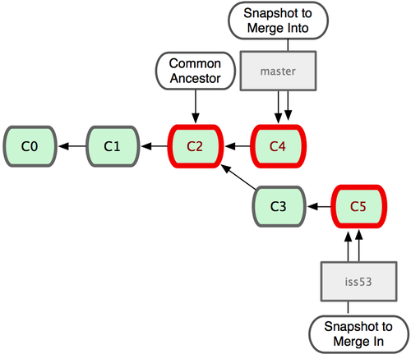
Branching and merging in Git (A branch life)
Git identifies the common ancestor and
does a three way merge

Slide 24
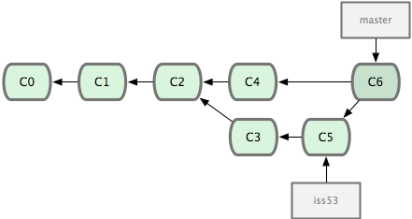
Branching and merging in Git (A branch life)
Git automatically created
a new commit which results from this merge

Slide 25
Branching and merging in Git (conflicts)
$ git merge iss53
Auto-merging index.html
CONFLICT (content): Merge conflict in index.html
Automatic merge failed; fix conflicts and then commit the result.
$ git status
index.html: needs merge
# On branch master
# Changed but not updated:
# (use "git add <file>..." to update what will be committed)
# (use "git checkout -- <file>..." to discard changes in working directory)
#
# unmerged: index.html
#

Slide 26
Branching and merging in Git (conflicts)
<<<<<<< HEAD:index.html
<div id="footer">contact : email.support@github.com</div>
=======
<div id="footer"> please contact us at support@github.com </div>
>>>>>>> iss53:index.html
Fix it!
$ git status
# On branch master
# Changes to be committed:
# (use "git reset HEAD <file>..." to unstage)
#
# modified: index.html
#
$ git commit
Merge branch 'iss53‘
Conflicts:
index.html
#
# It looks like you may be committing a MERGE.
# If this is not correct, please remove the file
# .git/MERGE_HEAD
# and try again.
#

Slide 27
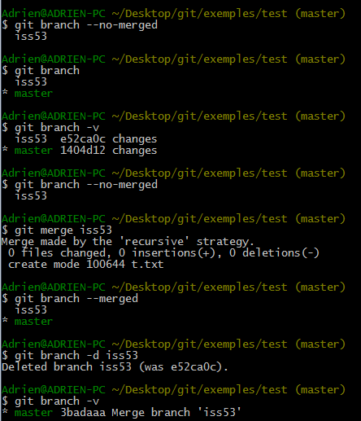
Branching and merging in Git (manage branches)

Slide 28
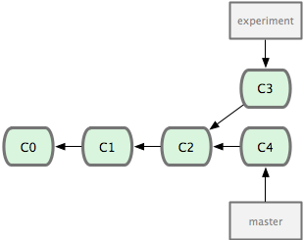
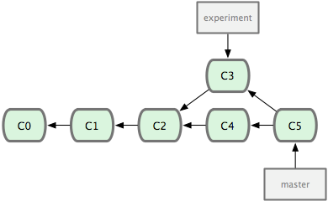
Branches in Git (rebase vs merge)
A merge does this :

Slide 29
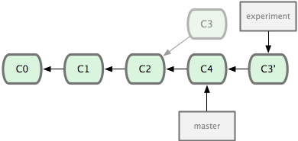
Branches in Git (rebase vs merge)
A rebase does that :

Slide 30
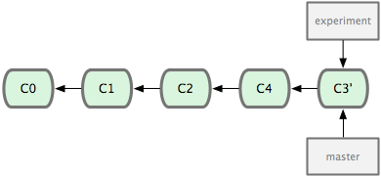
Branches in Git (rebase vs merge)
Rebase is interesting because
After rebasing, the merge is fast forward
You can rebase to integrate changes without creating a complex revision graph
After you can delete the old branch to have a cleaner log
YOU SHOULD ALWAYS BRANCH to not disturb the development branch
Sometimes you will merge, and sometimes rebase (when is a bit more complicated question)

Slide 31
Branches in Git (local / remote)
With SVN a branch, the trunk or a Tag was a server-side concept
With GIT everything is local
BUT : you will have also some remote branches:
branches shared with your teamates working on the same feature branch
The main development branch of the company
A test branch
A stable branch

Slide 32
Branches in Git (local / remote)
By default a local branch is not related to a remote one
You must explain what branch you want to use $ git push [remotename]/[branch] $ git pull [remotename]/[branch]
Origin, is the name of the remote you cloned from
Master is the local branch related to main branch of the origin remote (automatically connected when cloning)

Slide 33
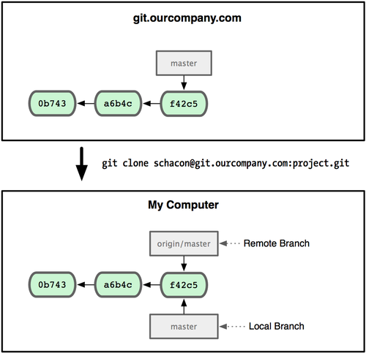
Branches in Git (local / remote)

Slide 34
Demo 4 (local / remote)
Publish a branch
Pull a branch

Slide 35
Branches in Git (connecting local / remote)
Connecting them make the push and pull command work without any other argument (like the master and the origin/master branches)
To create a local branch syncronized with a distant one $ git checkout--track [remotename]/[branch]
To set an existing branch traking a distant one $ git branch --set-upstream [branch] [remotename]/[branch]
To push a not tracking local branch to remote branch $ git push [remote_name] [local_branch_name]:[remote_branch_name]
To delete the remote branch, delete the tracking branch and push that change
Here you see how the work can be parallel, and Why it will be important to use rebase to have clean logs

Slide 36
Tags in Git
Create a tag
$ git tag v1.1 ## basic tag
$ git tag –a v1.5 –m «my easy annotated tag»
$ git tag –s v1.8 –m «my GPG signed tag» ## less used $ git show v1.8 ##shows the signature $ git tag –v v1.8 ## checks the signature
$ git tag -a v1.2 9fceb02 ## Create a tag later at revision 9fceb02
List tags
$ git tag
Sharing : like branches you can have local tags, or shared ones

Slide 37
Workflows : using branches
It is possible to use branches much more than with SVN
1 branch per feature (even localy)
1 branch to test a hotfix on you own computer without disturbing anyone, not even your own code
Adding tags easily

Slide 38
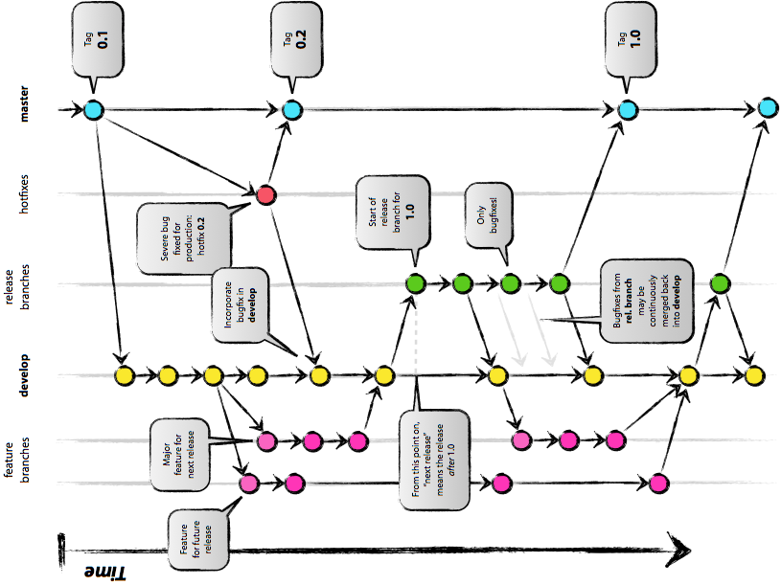

Slide 39
Workflows : git flow
Git flow helps you implement a good branching workflow.
Doing it with git command is really long
But it is only a command line tool yet
DEMO 5

Slide 40
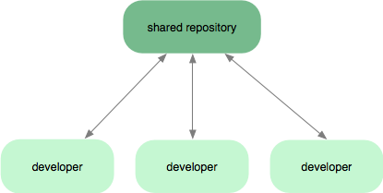
Workflows : using repositories (SVN-like)

Slide 41
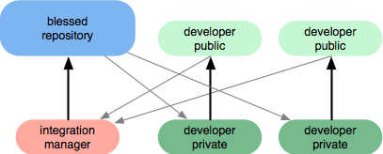
Workflows : integrator

Slide 42
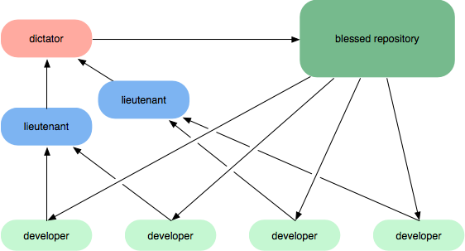
Workflows : lieutenants & dictator

Slide 43
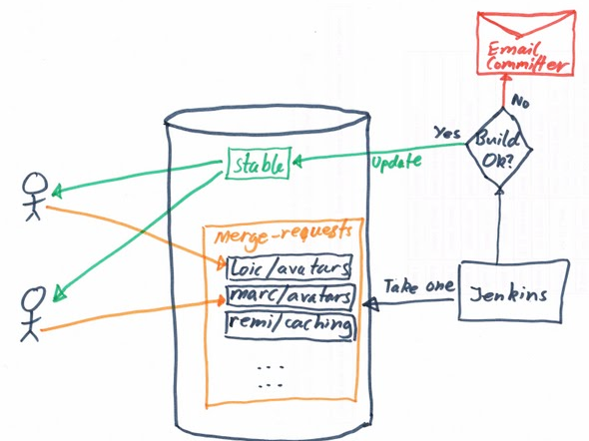
Workflows : intermediate repo test or review before to publish

Slide 44
Workflow possibilities with more repositories
As you see it is possible to do a lot of things
Adding intermediate repos to test, build, review before to make the code public
Having several repo per developer, to test before making the code public (ex : test on mac and Windows before making the code public)
Share the code within a team before making it public

Slide 45
Workflows : conclusion
There is much less contraints than with SVN, but you have to define your process
Having a lot of distant repos implies more steps distant operations (which can become anoying)
A lot of tools, help, and feedback can be found on the web.

Slide 46
Workflows : simple example
1 readable server
1 test+build repo (before to publish on the readable one)
1 private per developer
Some public repos for research or big changes in the code, for a team, for a project …

Slide 47
More advanced stuff
Pull = fetch + automatical merge
Reset and ammend
Submodules
Hooks
Some notes about Hg
Git clients

Slide 48
More advanced stuff (pull != fetch + merge)
Fetch is a simple download of a remote state IT DOES NOT CHANGE YOUR CODE
Pull is merging automatically (like update with SVN)
Doing a fetch and a merge gives you the opportunity to inspect changes before to merge them

Slide 49
More advanced stuff (reset and ammend)
Sometimes you see that just after a commit you forgot to commit a file. Then you should use git commit –ammend, this way you will not have 2 commits, but only 1. IT IS CLEANER
Sometimes you need to revert changes, this is the use of reset.
Going back to the unmodified file is $ git reset <filename> HEAD
You can also go back from several commits, or go back to a specific one
Finnaly it is usefull when you know your changes should be kept but in a branch instead of the master you were working on. Then branch the master, and do a $ git reset - -hard on the master to remove the changes.
More info : reset demystified

Slide 50
More advanced stuff (Use submodules and dependencies)
A submodule is a repository declared as a dependency of your repository.
You will have a clone of that repository in you main project repository
The submodule has a detached head : which means the it points to a commit and not to a branch head (it is like pointing to a specific revision, instead of pointing to a branch)
Submodules can be used with maven link

Slide 51
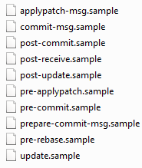
More advanced stuff (Hooks)
Note : the hooks folder contains some samples of scripts, to use them remove the « .sample »
Exemple : Automatic Unit test before commit
>> in .git/hooks/pre-commit
#!/bin/sh
# Run the test suite.
# It will exit with 0 if it everything compiled and tested fine.
ant test
if [ $? -eq 0 ]; then
exit 0
else
echo "Building your project or running the tests failed."
echo "Aborting the commit. Run with --no-verify to ignore."
exit 1
fi

Slide 52
More advanced stuff (Notes about Hg)
Submodules in Hg (wiki)
Integration to kiln

Slide 53
Git clients/browser
Windows
Git bash or Windows command line
TortoiseGit, GitExtensions, Git GUI
Mac
Command line
Source Tree
Mac & Win
Git-cola, smart git,
Web
Gitweb
Cgit (link)

Slide 54
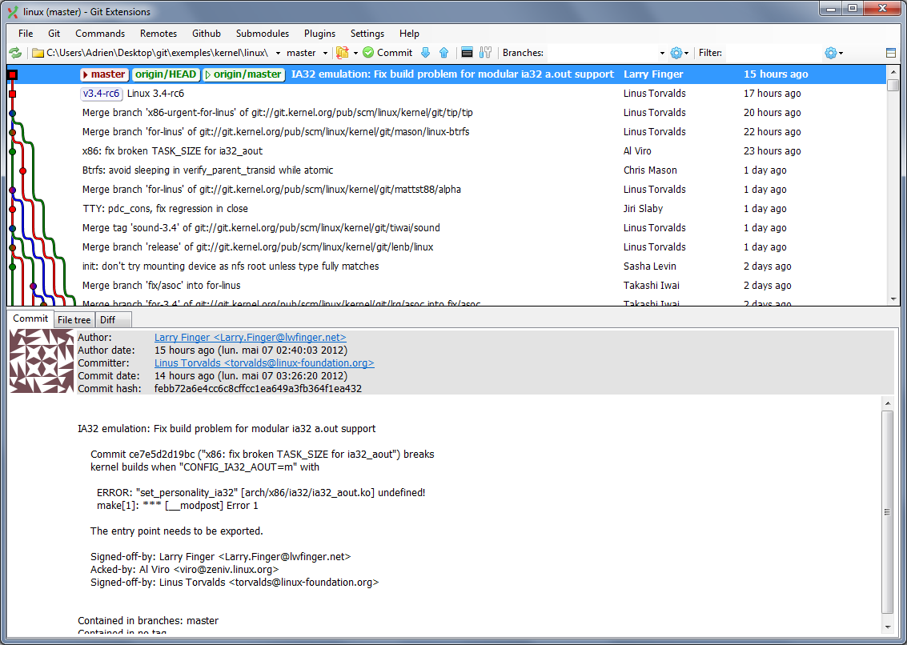
Repo examples

Slide 55
Why DVCS is better ? (part 1)
The repository is local
everything is local, except for pulling and fetching
You always can read the full history of the repository
You can commit/branch/merge locally
(whispers) « he hides the fact that it must be so heavy on hard drive »
Yes, It is heavier than a working copy
But everything is compressed when accessing to servers and obviously you do less requests to server (just to fetch it)

Slide 56
Why DVCS is better ? (part 2)
Merging is easyer than with SVN
Before SVN 1.5 no information about branches was stored
As SVN is centralized, any branch is public on the main server, you’ll never do a branch⬄a feature/fix
Branching is a central concept => It is easy, USE IT
No virtual directory
It is an hard object of the structure in Git, Hg and Bzr : As you’ve seen the repository is a graph (and is structure is directly related to branches)
Consequence : Incredible workflows
You can exchange with whoever you need to without breaking the shared code
You can branch/merge all the time

Slide 57
What is complicated in Git?
We must have a clear policy about branches (on the public repo(s))
IT IS NOT SVN
IT WILL NOT FIX YOUR CODE
10 reasons why SVN is better than Git

Slide 58
Sources
Websites
http://whygitisbetterthanx.com
Why git and not SVN
Boost move to git
Why switching to git
A succesfull git branching model
Video tutorials :
Git flow (and a great presentation)
Ebooks
Git Community book
Pro Git - Scott Chacon
OReilly.Version.Control.With.Git.May.2009

